Slide 1
2021 ASHRAE LowDown Showdown Modeling Competition
2021 Building Performance
Analysis Conference
Agua Viviente
Water Sustaining Life
Presentation Overview
Project Summary
Site Selection
Energy Efficiency/Resiliency Measures
Firm/Team Participation
Software Workflow
Conclusion
2021 ASHRAE LowDown Showdown Modeling Competition

Slide 2
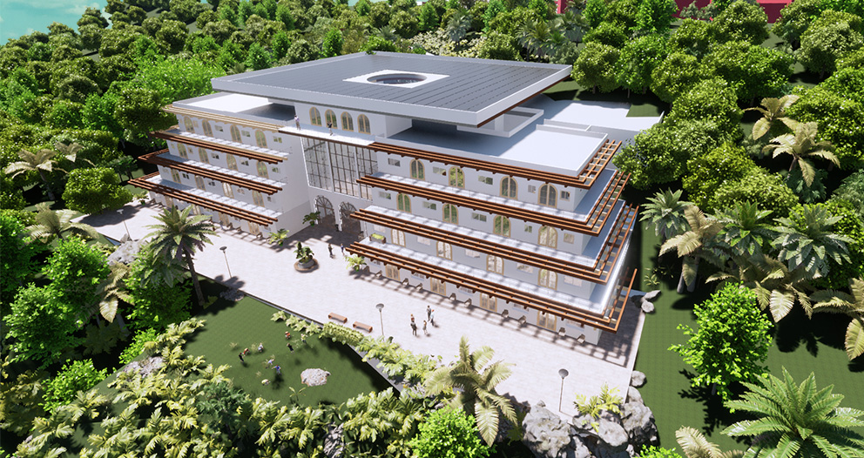
Agua Viviente Residential Care Center
EUI: 18.6 kBtu/ft2/yr
EUI 2030: 9.5 kBtu/ft^2/yr
CUI: 1.64 kgCO2e/ft^2
2021 ASHRAE LowDown Showdown Modeling Competition

Slide 3
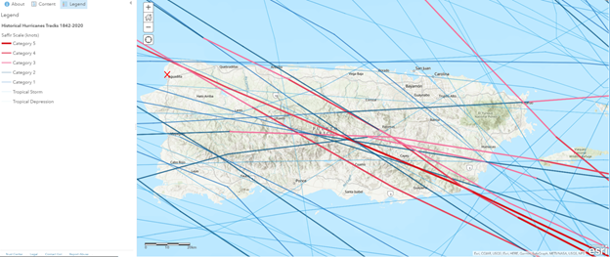
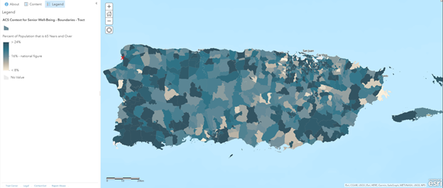
Site
Location Criteria:
Historical hurricane tracks
Senior well-being/Emergency Response Time
Borinquen, Aguadilla, Puerto Rico
2021 ASHRAE LowDown Showdown Modeling Competition

Slide 4
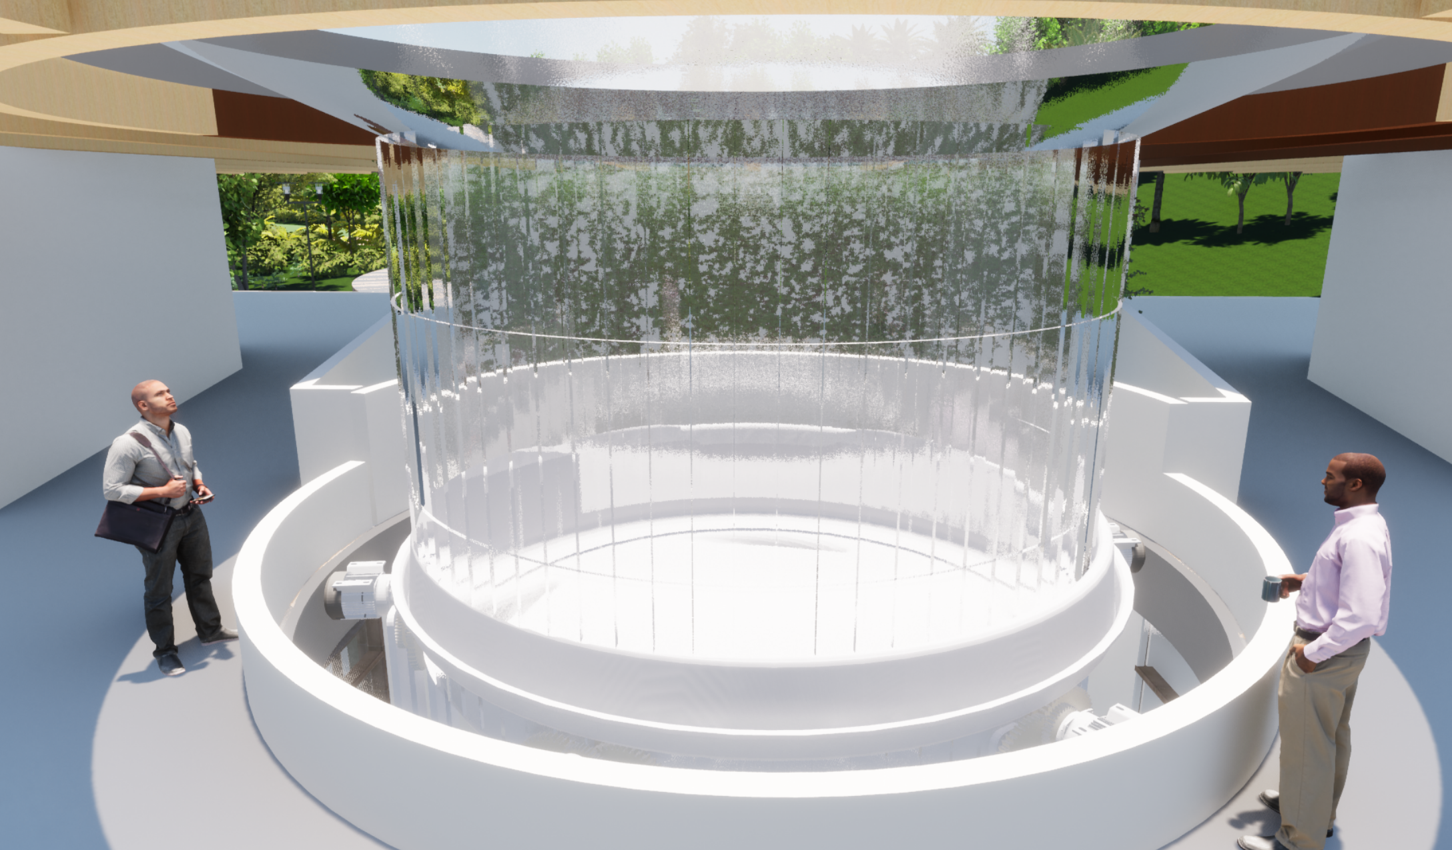
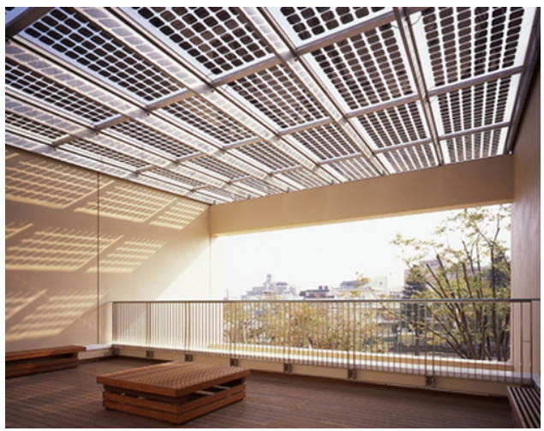
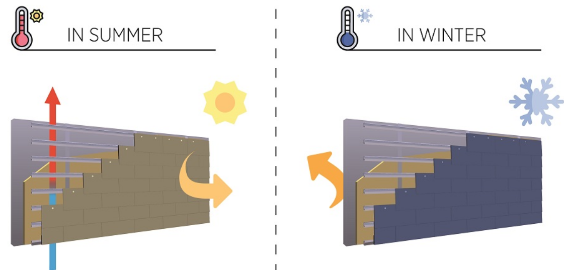
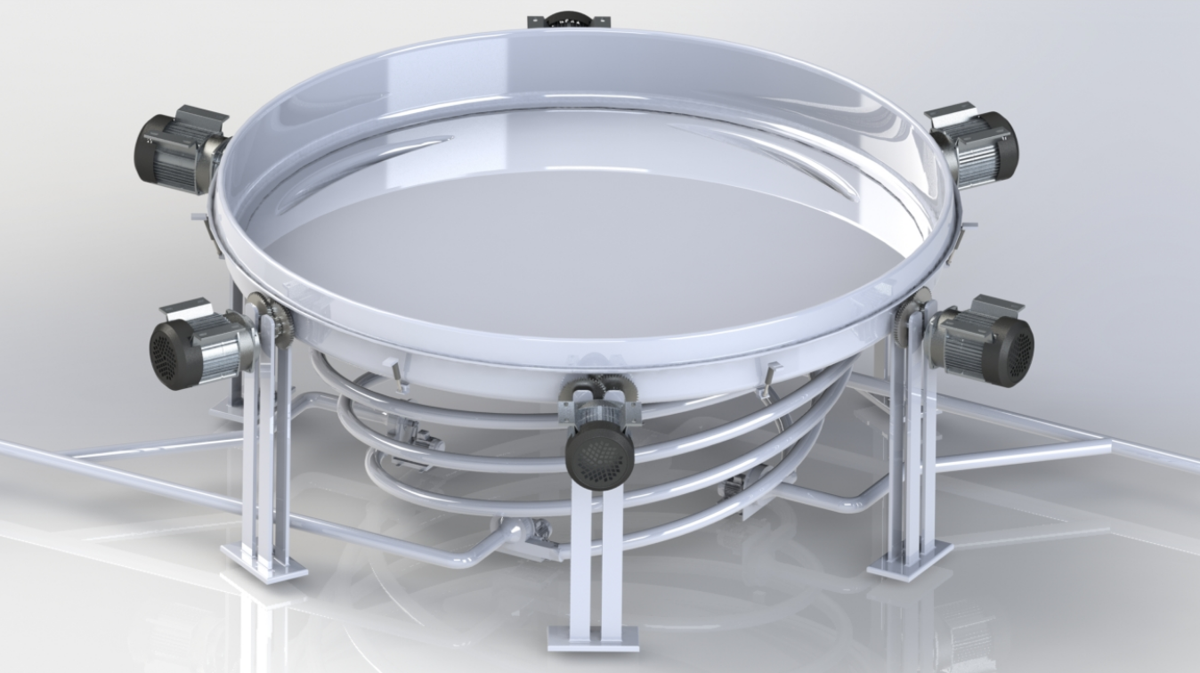
Energy Efficiency Measures
Turbine Supply Waterfall
Innovative Design
Utilize heavy yearly rainfall to provide a grandiose atrium waterfall
Direct rainfall into water turbine generation system
Transparent Solar Panels
Rainscreen Cladding
3-Stage Water Turbine
2021 ASHRAE LowDown Showdown Modeling Competition

Slide 5
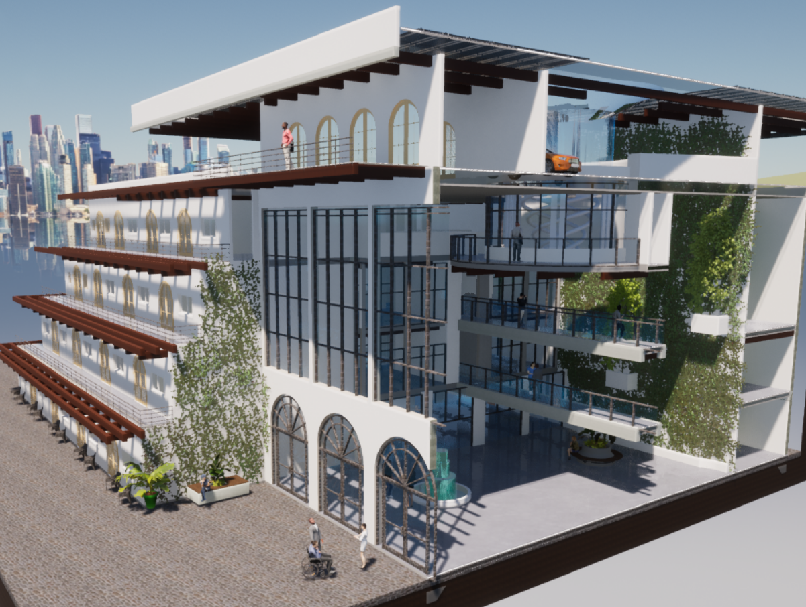
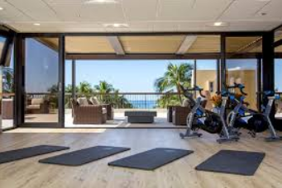
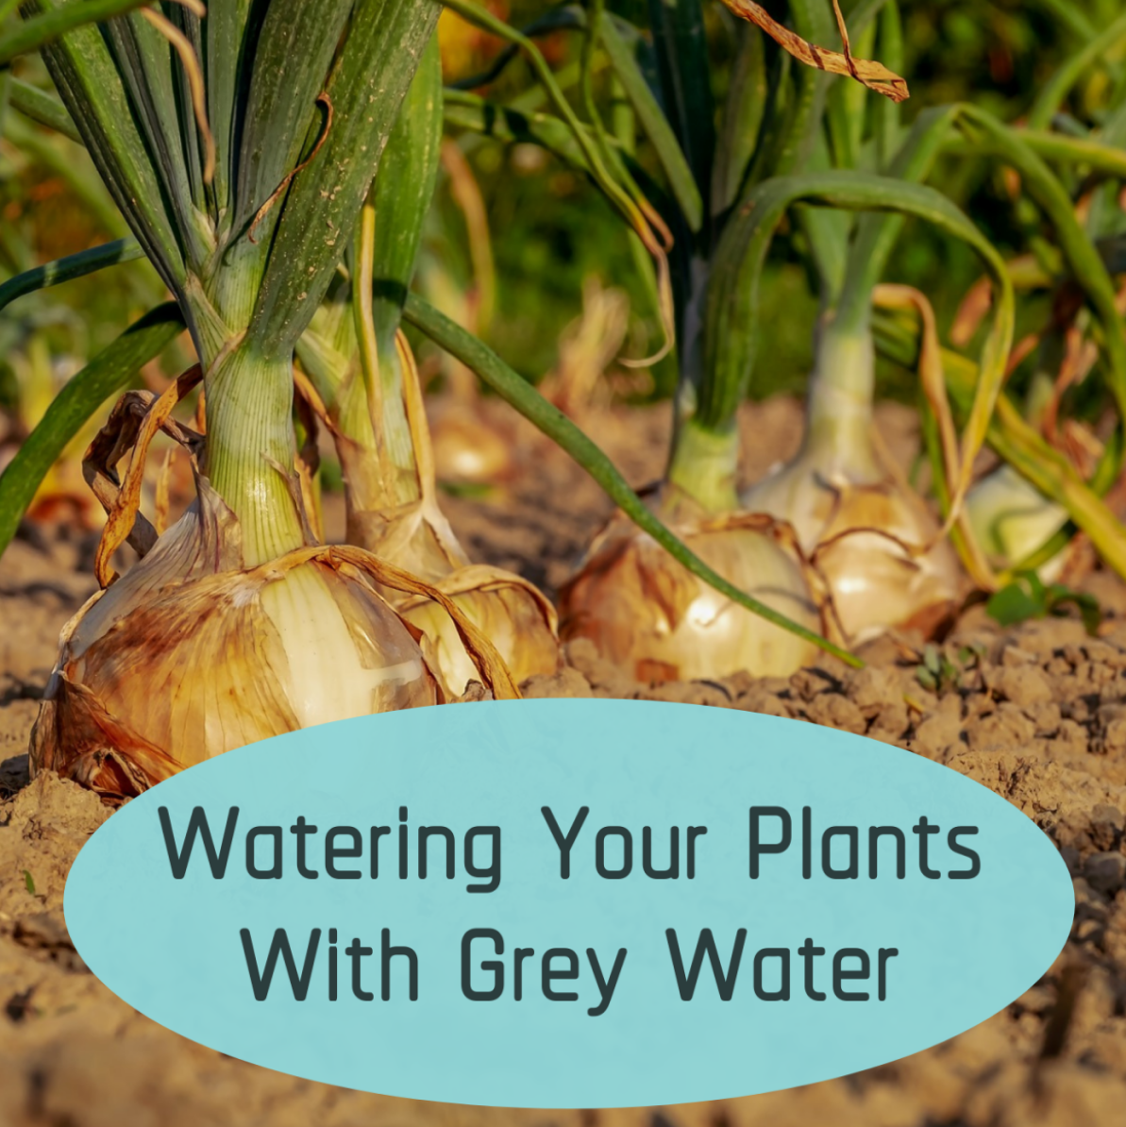
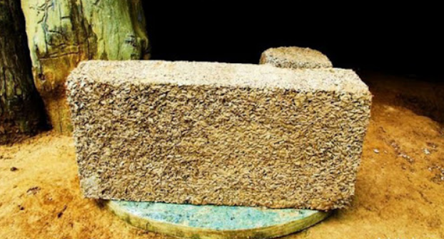
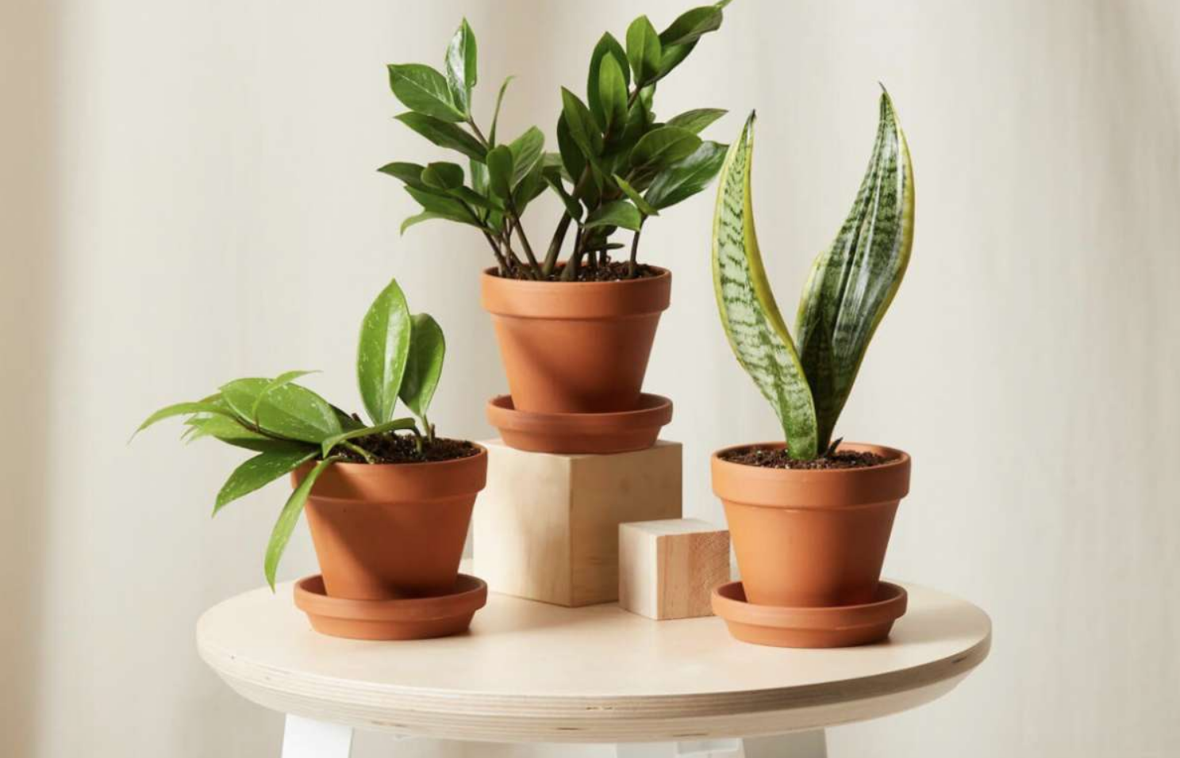
WELL Measures
Fitness Center paired with
natural foods throughout the day
5-Story Living Wall
Greywater onside watering system
Lowlight Plants
BioCrete
2021 ASHRAE LowDown Showdown Modeling Competition

Slide 6
Outdoor Activities
Walkways and glass room around Atrium
Gallery Space
Farmers Market - Arts and Crafts - Community Events
2021 ASHRAE LowDown Showdown Modeling Competition

Slide 7
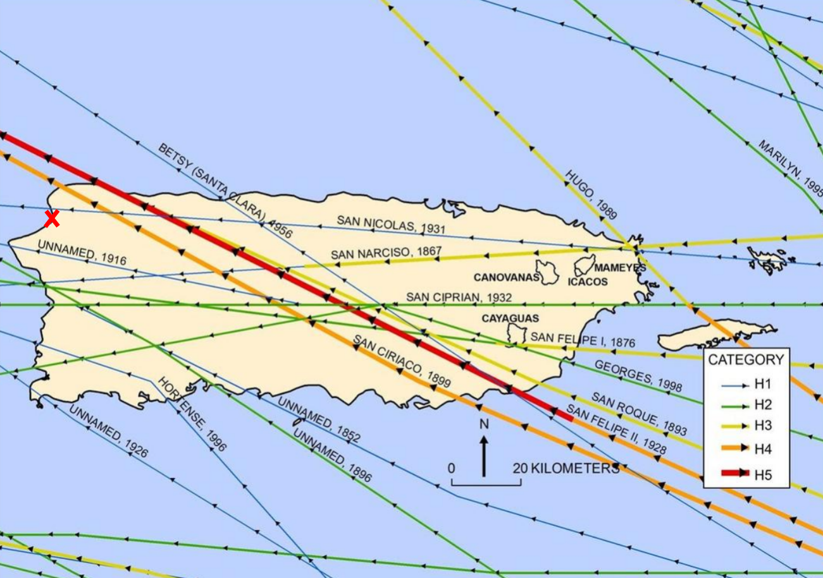
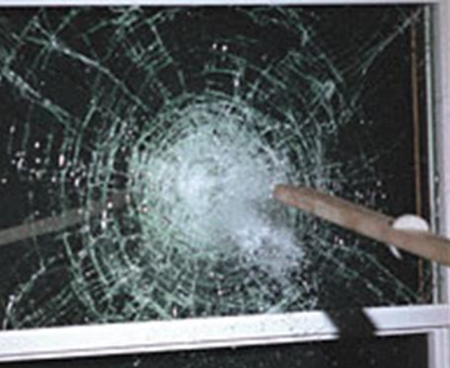
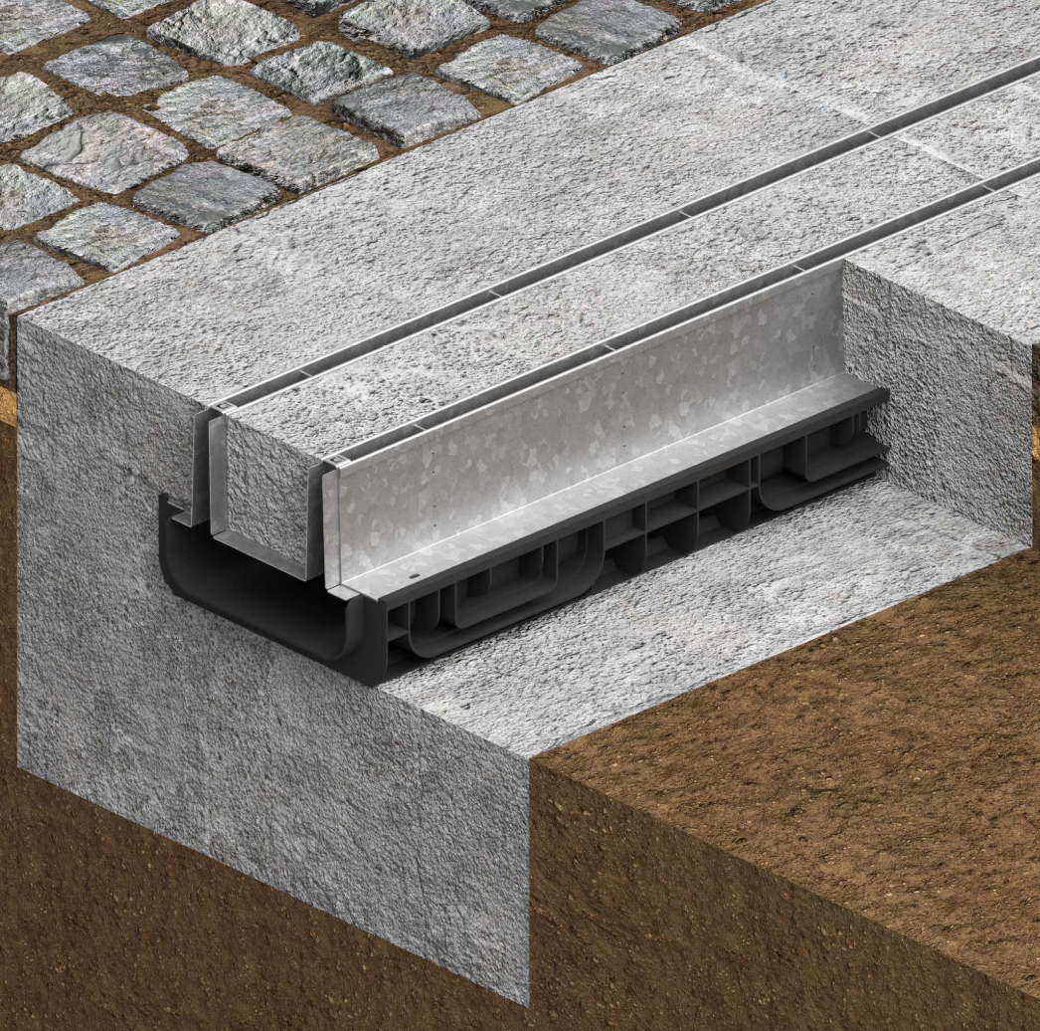
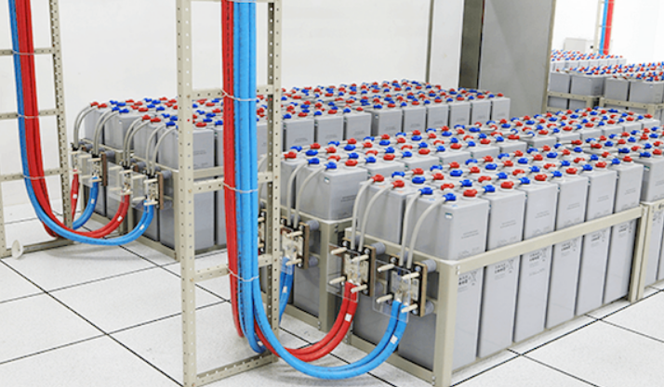
Resiliency Measures
Site Location
Hurricane Rated Windows
Inegrated Trench Drains
Site Generated Power Storage
2021 ASHRAE LowDown Showdown Modeling Competition

Slide 8
Agua Viviente Collaboration – Meet the Firms
BMA MECHANICAL+
REISS DESIGN STUDIO, PC
Consulting Engineering and Design Firm
Mechanical, Plumbing, Energy, Fire and Commissioning
Expertise in Commercial, Healthcare, Education, Multi-Family, Hospitality
Extensive 4,500+ project portfolio over a 30+yr period
Focused on excellence in design and setting the California Standard
Architectural Office with many interdisciplinary partners
Winery, Hospitality – LEED Certified Portfolio
Customized Solution – Oriented
Located on Central California – Retirement Communities
Research & Implementation
2021 ASHRAE LowDown Showdown Modeling Competition

Slide 9
Agua Viviente – Meet the Team
BMA
RDS
Dustin Lane (Senior Energy Analyst/Team Captain)
Kyler Peterson (Energy Specialist)
Pedro Salcedo (Energy Modeler)
Sarunas Banakas (Mechanical Designer)
Allison Bolla (Architectural Designer)
Jessica Haecherl (Architectural Drafter)
Esmeralda Zamora (Architectural Drafter)
2021 ASHRAE LowDown Showdown Modeling Competition

Slide 10
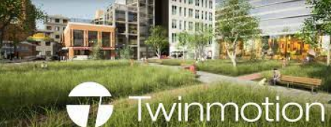
Software Use
Energy Analysis/PAT Software
Team Communication
Site Selection
Modeling Software
Rendering Software
2021 ASHRAE LowDown Showdown Modeling Competition

Slide 11
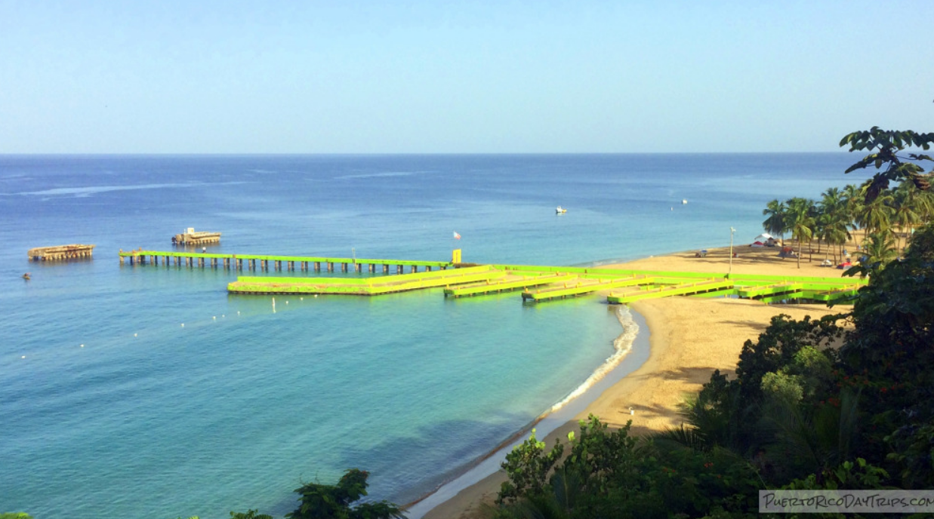
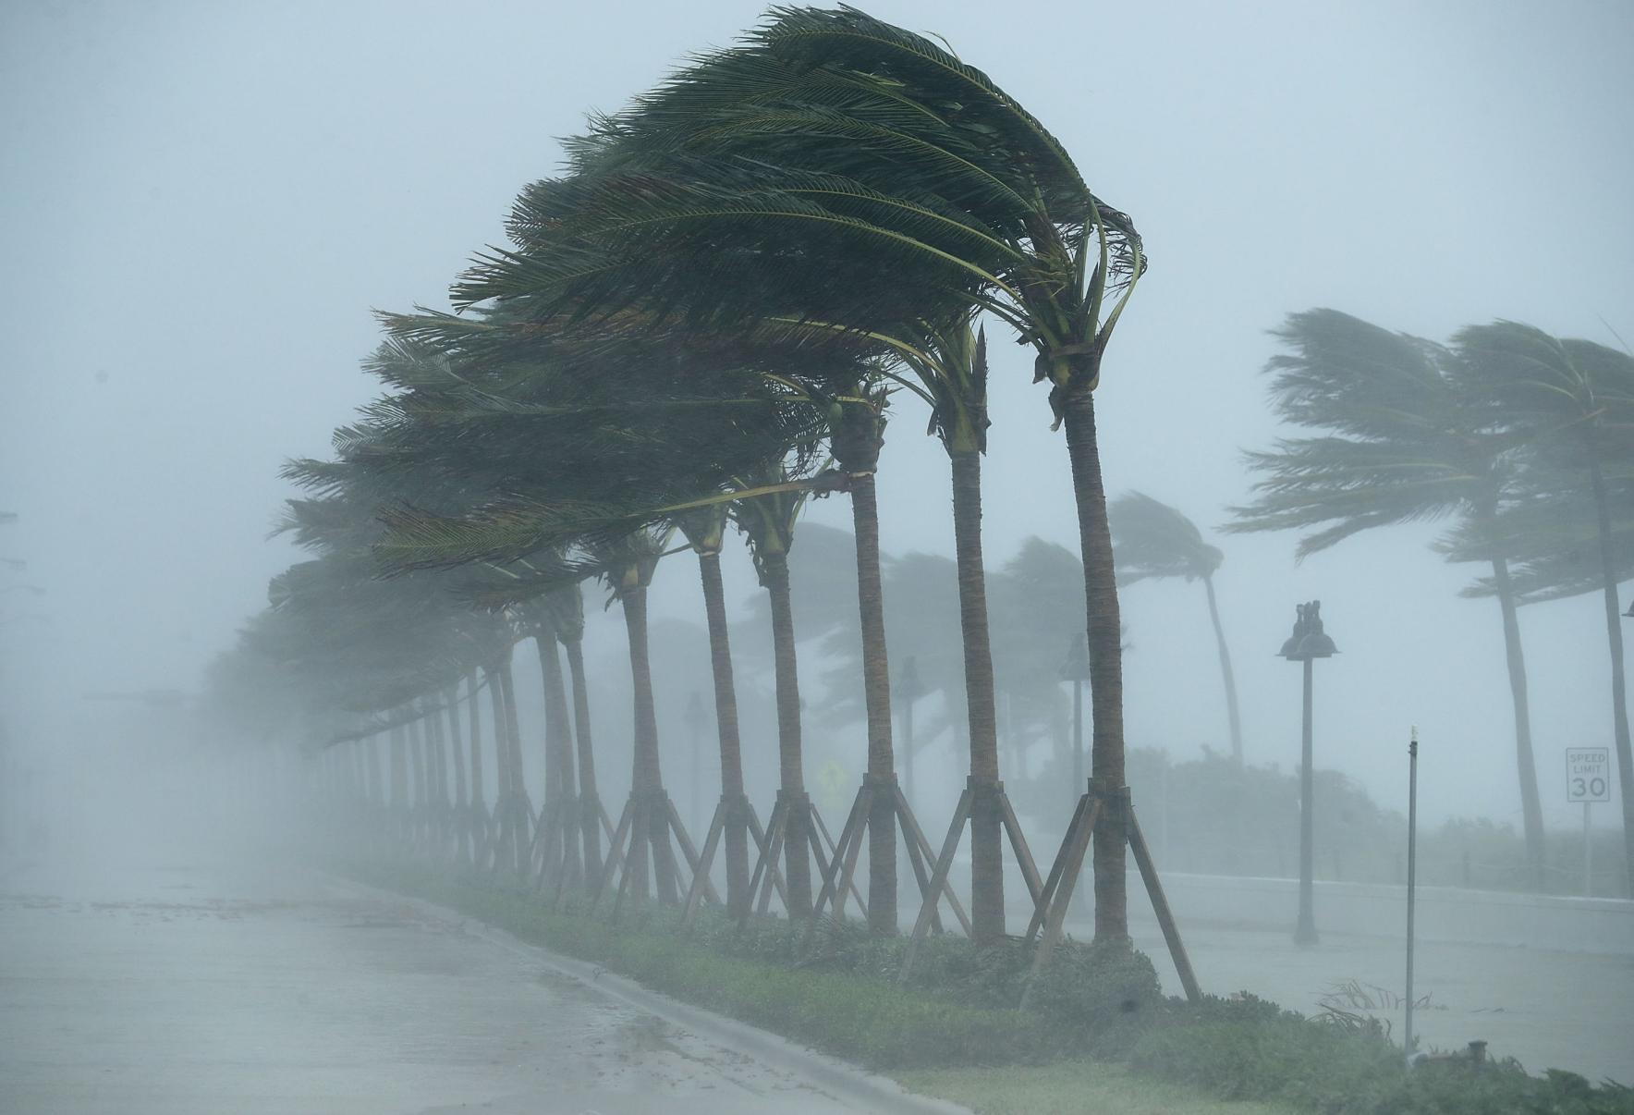
Community Engagement
Central to nineteen local beaches, minutes from the world renowned surfing beach Crash Boat Beach
Outdoor terrace and rooftop with spectacular ocean views
Atrium entrance waterfall which exhibits the capabilities of renewable resources to the community
Pathways through Puerto Rico's natural habitats outside Agua Viviente's front door
Hurricane shelter for locals and residents, with hurricane viewing windows
2021 ASHRAE LowDown Showdown Modeling Competition

Slide 12
Results Summary
 | IP | SI
Total Energy Use [kBtu - kWh] | 3,906,703 | 193
Total Water Use [gal - Liter] | 926,970 | 616
Total Onsite Production [kBtu - kWh] | 4,192,720 | 215
Total Energy & Water Cost [$] | 137,634 | 137,634
Total Site EUI [kBtu/ft2 – kWh/m2] | 18.6 | 58.9
Total CUI 2030 [kBtu/ft2 – kWh/m2] | 1.6 | 18
Total CUI 2050 [kBtu/ft2 – kWh/m2] | 1.6 | 18
2021 ASHRAE LowDown Showdown Modeling Competition

Slide 13
Conclusions
The design parameters offered a unique creative challenge pushing the limits of innovation, invoking us to develop the HydroTurbine power generation system. With prudent passive design techniques, this combined approach proved to be the most viable building solution
Mass proved to be our friend. In both energy production and passive design, mass provided a significant source of highly concentrated power generation and thermal stability
PV's have an inherently high carbon foot and low relative power production
Puerto Rico doesn't get very cold, and it rains a lot!
2021 ASHRAE LowDown Showdown Modeling Competition

